Slide 1




Quality Systems and Certifications
Unit: 5
Subject Name – Total Quality Management
Faculty Name – Mr. Minhaj Nezami
Assistant Professor
Department - IT
Course – B. Tech 8th semester

Slide 2

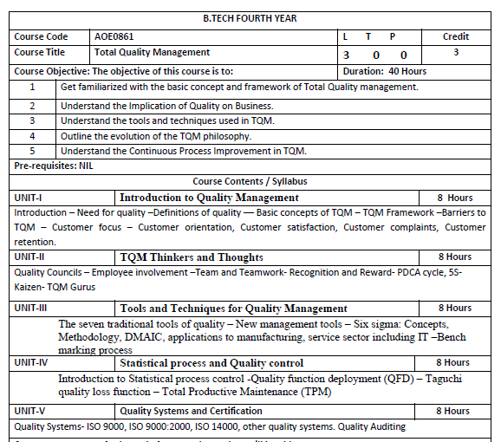

Slide 3
Contents
Course objectives
Course outcomes
Program outcome
CO-PO Mapping
Program Specific outcome
CO-PSO Mapping
Program Educational objectives
Unit Recap and pre cap
Syllabus of Unit 5
Objective of quality system
Pre cap of quality system
Quality system.
Recap of quality system
Objective of ISO
pre cap of ISO
ISO.
Recap of ISO

Slide 4
Contents
Objective of ISO 9000
Pre cap ISO 9000
ISO 9000.
Recap of ISO 9000
Daily quiz
Objective of ISO 9000:2000
Pre cap of ISO 9000:2000
ISO 9000:2000
Recap of ISO 9000:2000
Daily quiz
Objective of ISO 14000
Pre cap of ISO 14000
ISO 14000.
Recap of ISO 14000
Daily quiz

Slide 5
Contents
Objective of Quality Auditing
Pre cap of Quality Auditing
Quality Auditing
Recap of Quality Auditing
Daily quiz
Objective of JIT
Pre cap of JIT
JIT
Recap of JIT
Daily quiz
Video links
Weekly assignments
MCQs
Old question papers
Expected questions for university exam
Summary

Slide 6

AOE0861.1 | To learn about common term Quality Concepts
AOE0861.2 | To know TQM principle
AOE0861.3 | To understand the importance of different chart like P-charts and C-charts
AOE0861.4 | To know new term PDCE cycle, 5S,Kaizen
AOE0861.5 | To be aware about different ISO standards and JIT

Slide 7




Unit 5 Objective
To be aware about different ISO standards and JIT

Slide 8
Course Outcome
AOE0861.1 | Define the Quality Concepts and Manufacturing Quality
AOE0861.2 | Conceptualize the term Quality Management and relate to this various TQM Principles
AOE0861.3 | Analyze the different Tools and Techniques and Control Charts
AOE0861.4 | Distinguish between Defects Diagnosis and Prevention term
AOE0861.5 | Coordinate IS0 and its concept to Quality Management

Slide 9
Program Outcome
1. Engineering knowledge
2. Problem analysis
3. Design/development of solutions
4. Conduct investigations of complex problems
5. Modern tool usage
6. The engineer and society
7. Environment and sustainability
8. Ethics
9. Individual and team work
10. Communication
11. Project management and finance
12. Life-long learning

Slide 10
CO-PO Mapping
CO | PO1 | PO2 | PO3 | PO4 | PO5 | PO6 | PO7 | PO8 | PO9 | PO10 | PO11 | PO12
AOE0861.1 | 3 | 3 | 2 | 2 | 1 | 2 | 2 | 1 | 1 | 1 | 2 | 3
AOE0861.2 | 3 | 3 | 3 | 3 | 2 | 2 | 2 | 1 | 1 | 1 | 2 | 3
AOE0861.3 | 3 | 3 | 2 | 3 | 3 | 2 | 2 | 1 | 2 | 1 | 2 | 3
AOE0861.4 | 3 | 2 | 3 | 2 | 2 | 2 | 2 | 1 | 2 | 1 | 3 | 3
AOE0861.5 | 3 | 2 | 3 | 2 | 2 | 2 | 2 | 1 | 2 | 1 | 2 | 3
Avg | 3 | 2.6 | 2.6 | 2.4 | 2 | 2 | 2 | 1 | 1.6 | 1 | 2.2 | 3

Slide 11
Program Specific Outcome
On successful completion of graduation degree, The computer Science & Engineering graduates will be able to:
PSO 1: identify, analyze real world problems and design their ethical solutions using artificial intelligence, robotics, virtual/augmented reality, data analytics, block chain technology, and cloud computing.
PSO 2: design and develop the hardware sensor devices and related interfacing software systems for solving complex engineering problems.
PSO 3: understand inter-disciplinary computing techniques and to apply them in the design of advanced computing.
PSO 4: conduct investigation of complex problem with the help of technical, managerial, leadership qualities, and modern engineering tools provided by industry sponsored laboratories.

Slide 12
CO-PSO Mapping
CO | PSO1 | PSO2 | PSO3
AOE0861.1 | 3 | 2 | 3
AOE0861.2 | 3 | 2 | 2
AOE0861.3 | 3 | 2 | 3
AOE0861.4 | 3 | 3 | 3
AOE0861.5 | 3 | 2 | 3
Avg | 3 | 2.2 | 2.8

Slide 13
Program Educational Objective
PEO 1: To have an excellent scientific and engineering breadth so as to comprehend, analyze, design and provide sustainable solutions for real-life problems using state-of-the-art technologies.
PEO 2: To have a successful career in industries, to pursue higher studies or to support
entrepreneurial endeavors and to face the global challenges.
PEO 3: To have an effective communication skills, professional attitude, ethical values
and a desire to learn specific knowledge in emerging trends, technologies for research,
innovation and product development and contribution to society.
PEO 4: To have life-long learning for up-skilling and re-skilling for successful
professional career as engineer, scientist, entrepreneur and bureaucrat for betterment
of society.

Slide 14
Unit Recap and Precap
RECAP
1. Quality circle
2. Zero defect
3. Kaizen
PRECAP
Quality system
ISO
Environmental Management

Slide 15
Syllabus of Unit 5
Quality Systems and Certification:
Quality Systems- ISO 9000, ISO 9000:2000, ISO 14000, other quality systems. Quality Auditing

Slide 16
Objective of Quality System
Quality System is organization’s blueprint. it identifies business model and processes, provides details about how people will work together to get things done.
CO | PO1 | PO2 | PO3 | PO4 | PO5 | PO6 | PO7 | PO8 | PO9 | PO10 | PO11 | PO12
AOE0861.1 | 3 | 2 | 3 | 2 | 2 | 2 | 2 | 1 | 2 | 1 | 2 | 3

Slide 17
Prerequisite of Quality System
As the organizational structure, responsibilities, procedures, processes, and resources needed to implement quality management. A closely related term is Good Manufacturing Practices

Slide 18
Quality System (CO5)
A quality system is formally described as 'the organizational structure, responsibilities, procedures, processes and resources for implementing the management of quality'. Said in a simpler way, a quality system concerns the way an enterprise goes about running its business to achieve its goals (effectively or otherwise!).
The quality system would usually be documented and is often based around a quality manual that defines and embodies the system.
A “Quality System” is your organization’s blueprint: it identifies your business model and processes, provides details about how your people will work together to get things done, and establishes specifications for performance — so you can tell if you’re on track… or not.

Slide 19
Quality System (CO5)
Many manufacturing and service enterprises have their quality systems certified against a recognized quality management standard, commonly one of the international ISO 9000 standards.
Such standards lay down generic elements of good business practice that the enterprise must implement and follow in order to gain certification
It is often the case today that organizations are required to be certified against a particular standard for contractual or regulatory reasons.
Meat processing companies and nursing homes, for instance, must comply with government imposed standards in order to demonstrate that the processors produce food that is safe to eat and that the homes provide a caring environment for elderly people.

Slide 20
Quality System (CO5)
Having a certified quality system can inspire credibility in the eyes of customers and suppliers as well as helping the organization to run more efficiently.
However, it should be said that a quality system does not need to be certified for it to work well.
Independent bodies are specifically accredited to grant certification. Certification occurs after a thorough assessment or audit of the organization's quality system and operations.
Regular follow-up audits are necessary to demonstrate on-going compliance, otherwise certification may be withdrawn.

Slide 21
Quality System (CO5)
A quality management system (QMS, alternatively “quality system”) is a mechanism for managing and continuously improving core processes to “achieve maximum customer satisfaction at the lowest overall cost to the organization”.
By bringing together philosophies, standards, methodologies and tools, the QMS helps an organization achieve its quality-related goals.
A quality system is a specific implementation of quality philosophies/concepts, standards, methodologies and tools, for the purpose of achieving quality-related goals.
When implemented, a quality system will be unique to an organization. Its structure, however, may be similar to quality systems in other organizations

Slide 22
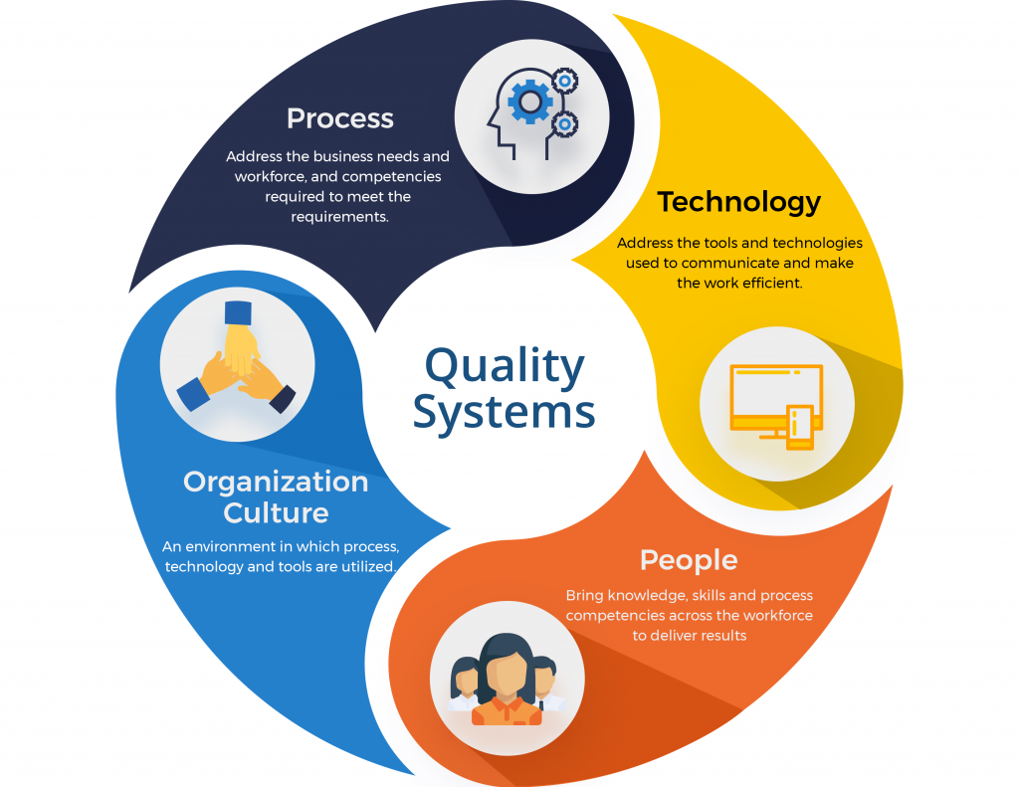
Quality System (CO5)

Slide 23
Recap of Quality System
A quality management system (QMS, alternatively “quality system”) is a mechanism for managing and continuously improving core processes to “achieve maximum customer satisfaction at the lowest overall cost to the organization.

Slide 24
Daily Quiz
What is Quality System?
What is the need of quality system?
What are the advantages of Quality system?
What is the structure of quality system?
Which one series is used in quality system?

Slide 25
Objective of ISO
ISO (International Organization for Standardization) is an independent, non-governmental, international organization that develops standards to ensure the quality, safety, and efficiency of products, services, and systems.
CO | PO1 | PO2 | PO3 | PO4 | PO5 | PO6 | PO7 | PO8 | PO9 | PO 10 | PO 11 | PO 12
AOE0861.1 | 3 | 2 | 3 | 2 | 2 | 2 | 2 | 1 | 2 | 1 | 2 | 3

Slide 26
Prerequisite of ISO
Quality management System
A quality management system (QMS, alternatively “quality system”) is a mechanism for managing and continuously improving core processes to “achieve maximum customer satisfaction at the lowest overall cost to the organization

Slide 27
ISO (CO5)
ISO (International Organization for Standardization) is a worldwide federation of national standards bodies.
ISO is a nongovernmental organization that comprises standards bodies from more than 160 countries, with one standards body representing each member country. The American National Standards Institute (ANSI) for example, represents the United States.

Slide 28
ISO (CO5)
Member organizations collaborate in the development and promotion of international standards for technology, scientific testing processes, working conditions, societal issues and more. ISO and its members then sell documents detailing these standards.
A General Assembly, which consists of representatives from ISO members and elected leaders called principal officers, acts as the decision-making body for ISO. The organization has its headquarters in Geneva, Switzerland, where a central secretariat oversees operations.

Slide 29
ISO (CO5)
ISO standards development process
The International Organization for Standardization's process for creating a new standard starts when industry associations or consumer groups make a request.
ISO then recruits subject matter experts and industry stakeholders who form a technical committee. The committee goes through two rounds of creating a draft standard and conducts a formal vote on the second draft, which is called the Final Draft International Standard (FDIS).
If the FDIS is approved, as certified by the central secretariat, then ISO publishes it as an official international standard.

Slide 30
ISO (CO5)
What is ISO Certification?
ISO certification certifies that a management system, manufacturing process, service, or documentation procedure has all the requirements for standardization and quality assurance. ISO (International Organization for Standardization) is an independent, non-governmental, international organization that develops standards to ensure the quality, safety, and efficiency of products, services, and systems.

Slide 31
ISO (CO5)
ISO certifications exist in many areas of industry, from energy management and social responsibility to medical devices and energy management. ISO standards are in place to ensure consistency. Each certification has separate standards and criteria and is classified numerically.
An ISO Management Standard is a set of internationally recognized guidelines, covering key areas of running and managing a business such as:
Leadership and commitment

Slide 32
ISO(CO5)
ISO (CO5)
Managing Business Risks and Opportunities
Resources such as, People and Infrastructure
Competence
Communication
Operational Planning and Control
Performance Evaluation
Improvement

Slide 33
ISO (CO5)
An ISO management standard is a way of running your operations so they are consistent and effective. It is viewed as business best practice.
The most common benefits include:
Increased efficiency
Reduced costs
Improved customer satisfaction
More engaged employees
Reduced risks
If you are an owner managed business, ISO Management Systems can help make your business more attractive to potential buyers. If your long term strategy is to obtain an investor or sell the business, ISO Certification can help.

Slide 34
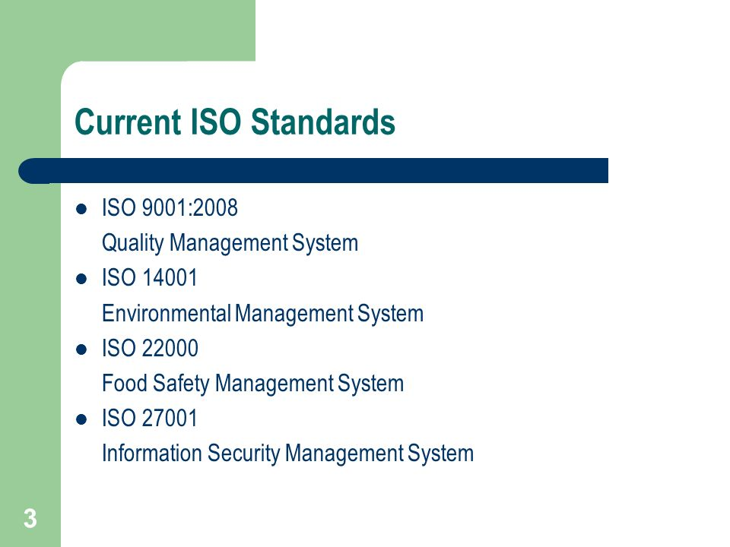
ISO (CO5)
.

Slide 35
Recap of ISO
ISO (CO5)
ISO certification certifies that a management system, manufacturing process, service, or documentation procedure has all the requirements for standardization and quality assurance.

Slide 36
Daily Quiz
What are ISO?
How many Standards are in current ISO?
What are the benefit of ISO?
What are the key areas of ISO for running and managing?
What is ISO Certification?

Slide 37
Objective of ISO 9000
ISO 9000 can help a company satisfy its customers, meet regulatory requirements, and achieve continual improvement
CO | PO1 | PO2 | PO3 | PO4 | PO5 | PO6 | PO7 | PO8 | PO9 | PO10 | PO11 | PO12
AOE0861.1 | 3 | 2 | 3 | 2 | 2 | 2 | 2 | 1 | 2 | 1 | 2 | 3

Slide 38
Prerequisite of ISO 9000
Current ISO Standard
ISO Certification

Slide 39
ISO 9000 (CO5)
ISO 9000 is defined as a set of international standards on quality management and quality assurance developed to help companies effectively document the quality system elements needed to maintain an efficient quality system.
They are not specific to any one industry and can be applied to organizations of any size.
ISO 9000 can help a company satisfy its customers, meet regulatory requirements, and achieve continual improvement. It should be considered to be a first step or the base level of a quality system.

Slide 40
ISO 9000 (CO5)
ISO 9000 was first published in 1987 by the International Organization for Standardization (ISO), a specialized international agency for standardization composed of the national standards bodies of more than 160 countries. The standards underwent major revisions in 2000 and 2008. The most recent versions of the standard, ISO 9000:2015 and ISO 9001:2015, were published in September 2015.
An ISO 9001 Quality Management System is a consistent way of doing things which ensures that your products or services meet your customers’ needs.

Slide 41
ISO 9000 (CO5)
Improving your Quality Management System (QMS) to the level required by the ISO, strengthens your business performance; helping to protect it from whatever challenges lie ahead. It also helps to increase your market share and profit potential.
ISO 9000 VS. 9001
ISO 9000 is a series, or family, of quality management standards, while ISO 9001 is a standard within the family. The ISO 9000 family of standards also contains an individual standard named ISO 9000. This standard lays out the fundamentals and vocabulary for quality management systems (QMS).

Slide 42
ISO 9000 (CO5)
ISO 9001 Definition
The certification ISO 9001:2008 includes three components: ISO, 9001, and 2008. Here's what each component represents:
ISO
As mentioned above, ISO refers to the International Organization for Standardization. This organization develops the standards, and it does in order to certify businesses or organizations. Certification is handled third-party and tested annually.

Slide 43
ISO 9000 (CO5)
9001
The number appearing after ISO classifies the standard. All standards within the ISO 9000 family refer to quality management. ISO 9001 is among ISO's best-known standards.
It defines the criteria for meeting a number of quality management principles. It helps businesses and organizations be more efficient and improve customer satisfaction.

Slide 44
ISO 9000 (CO5)
2008
The final number in an ISO certification refers to the version of the standard that's being met and is represented by the calendar year those standards were launched. 2008 is the fourth edition of ISO 9001. The newest version, ISO 9001:2015, was launched in September 2015, and Mead Metals is currently updating its processes to meet the specifications of this newest version.
ISO 9000:2000
ISO 9000:2000 refers to the ISO 9000 update released in the year 2000.

Slide 45
ISO 9000 (CO5)
The ISO 9000:2000 revision had five goals:
Meet stakeholder needs
Be usable by all sizes of organizations
Be usable by all sectors
Be simple and clearly understood
Connect quality management system to business processes

Slide 46

ISO 9000 (CO5)

Slide 47
Recap of ISO 9000
An ISO 9000 Quality Management System is a consistent way of doing things which ensures that your products or services meet your customers’ needs.

Slide 48
Daily Quiz
What is ISO 9000?
What are the difference between ISO 9000 and ISO 9001?
What are the benefit ISO 9000?
What is ISO 9001?
What are the goals of ISO 9000:2000 ?

Slide 49
Objective of ISO 9000:2000
ISO 9000:2000 helps organizations do things better, keep customers happy, and continuously improve.
CO | PO 1 | PO2 | PO3 | PO4 | PO 5 | PO 6 | PO 7 | PO 8 | PO 9 | PO 10 | PO 11 | PO12
AOE0861.1 | 3 | 2 | 3 | 2 | 2 | 2 | 2 | 1 | 2 | 1 | 2 | 3

Slide 50
Objective of ISO 9000:2000
Improve product and service quality
Increase customer satisfaction and trust
Promote a process-based approach to management
Encourage continual improvement
Ensure compliance with regulatory and statutory requirements
Enhance internal efficiency and communication
Provide a globally recognized framework for quality assurance
CO | PO 1 | PO2 | PO3 | PO4 | PO 5 | PO 6 | PO 7 | PO 8 | PO 9 | PO 10 | PO 11 | PO12
AOE0861.1 | 3 | 2 | 3 | 2 | 2 | 2 | 2 | 1 | 2 | 1 | 2 | 3

Slide 51
Prerequisite of ISO 9000:2000
ISO 9000
ISO 9001

Slide 52
ISO 9000:2000 (CO5)
International standard for Quality Management Systems (QMS)Updated version released in the year 2000Focused on customer satisfaction and continuous improvement. Applicable to all types of organizations.

Slide 53
ISO 9000:2000 (CO5)
Key Principles:
Customer focus
Leadership
Involvement of people
Process approach
System approach to management
Continual improvement
Factual decision-making
Mutually beneficial supplier relationships

Slide 54
ISO 9000:2000 (CO5)
Process Approach:
Activities linked as processes
Improved consistency and performance
Better use of resources

Slide 55
ISO 9000:2000 (CO5)
Documentation Structure:
Quality Manual
Documented procedures
Work instructions
Records for compliance

Slide 56
ISO 9000:2000 (CO5)
Requirements of ISO 9001:2000:
QMS documentation
Management responsibility
Resource management
Product realization
Measurement, analysis & improvement

Slide 57
ISO 9000:2000 (CO5)
Benefits:
Enhanced customer satisfaction
Improved operational efficiency
Better internal communication
Stronger supplier relationships
Competitive advantage in the market

Slide 58
ISO 9000:2000 (CO5)
ISO 9000:2000 improves product quality, operational control, and customer trust through a structured and continuous improvement approach.

Slide 59
Recap of ISO 9000:2000
ISO 9000:2000 improves product quality, operational control, and customer trust through a structured and continuous improvement approach.

Slide 60
Daily Quiz
Explain the eight Quality Management Principles of ISO 9000:2000.
Describe the structure and documentation requirements of the QMS.
Discuss the role of management in implementing ISO 9000:2000.
Explain the benefits of adopting ISO 9000:2000 in an organization.
Write in detail about internal audits and continual improvement.

Slide 61
Objective of ISO 14000
The standards specify requirements for establishing an environmental management policy, determining environmental impacts of products or services, planning environmental objectives.
CO | PO1 | PO2 | PO3 | PO4 | PO 5 | PO 6 | PO 7 | PO 8 | PO 9 | PO 10 | PO 11 | PO12
AOE0861.1 | 3 | 2 | 3 | 2 | 2 | 2 | 2 | 1 | 2 | 1 | 2 | 3

Slide 62
Prerequisite of ISO 14000
ISO 9000
ISO 9001

Slide 63
ISO 14000 (CO5)
ISO 14000 is defined as a series of international environmental management standards, guides, and technical reports. The standards specify requirements for establishing an environmental management policy, determining environmental impacts of products or services, planning environmental objectives, implementing programs to meet objectives, and conducting corrective action and management review.

Slide 64
ISO 14000 (CO5)
PROMOTING ENVIRONMENTAL MANAGEMENT SYSTEMS WITH ISO 14000
The primary objective of the ISO 14000 series of standards is to promote effective environmental management systems in organizations. The standards seek to provide cost-effective tools that make use of best practices for organizing and applying information about environmental management.

Slide 65
ISO 14000 (CO5)
The ISO 14000 family was developed in response to a recognized industry need for standardization. With different organizational approaches to environmental management, comparisons of systems and collaboration had proved difficult.
ISO 14000 includes several standards that cover aspects of the managing practice’s inside facilities, the immediate environment around the facilities, and the life cycle of the actual product. This includes understanding the impact of the raw materials used within the product, as well as the impact of product disposal.

Slide 66
ISO 14000 (CO5)
The most notable standard is ISO 14001, which lays out the guidelines for putting an environmental management system (EMS) in place. Then there’s ISO 14004, which offers additional insight and specialized standards for implementing an EMS.
Here are the key standards included in ISO 14000:
ISO 14001: Specification of Environmental Management Systems
ISO 14004: Guideline Standard

Slide 67
ISO 14000 (CO5)
ISO 14010 – ISO 14015: Environmental Auditing and Related Activities
ISO 14020 – ISO 14024: Environmental Labeling
ISO 14031 and ISO 14032: Environmental Performance Evaluation
ISO 14040 – ISO 14043: Life Cycle Assessment
ISO 14050: Terms and Definitions

Slide 68
ISO 14000 (CO5)
Benefits of ISO 14000 Certification
ISO 14000 certification can be achieved by having an accredited auditor verify that all the requirements are met, or a company may self-declare. Obtaining the ISO 14000 certification can be considered a sign of a commitment to the environment, which can be used as a marketing tool for companies. It may also help companies meet certain environmental regulations.

Slide 69
ISO 14000 (CO5)
WHAT IS THE ISO 14001 ENVIRONMENTAL MANAGEMENT SYSTEM?
An ISO 14001 Environmental Management System is a way of managing the aspects of your business which have a significant impact on the environment.
Improving your Environmental Management System (EMS) to the level required by ISO 14001, helps to protect it from reputational damage and benefit from cost savings. It can help increase your employee engagement and improve your legal and regulatory compliance.

Slide 70
Prerequisite of ISO 14000
ISO 9000
ISO 9001

Slide 71
ISO 14000 (CO5)
ISO 14000 is defined as a series of international environmental management standards, guides, and technical reports. The standards specify requirements for establishing an environmental management policy, determining environmental impacts of products or services, planning environmental objectives, implementing programs to meet objectives, and conducting corrective action and management review.

Slide 72
ISO 14000 (CO5)
PROMOTING ENVIRONMENTAL MANAGEMENT SYSTEMS WITH ISO 14000
The primary objective of the ISO 14000 series of standards is to promote effective environmental management systems in organizations. The standards seek to provide cost-effective tools that make use of best practices for organizing and applying information about environmental management.

Slide 73
ISO 14000 (CO5)
The ISO 14000 family was developed in response to a recognized industry need for standardization. With different organizational approaches to environmental management, comparisons of systems and collaboration had proved difficult.
ISO 14000 includes several standards that cover aspects of the managing practice’s inside facilities, the immediate environment around the facilities, and the life cycle of the actual product. This includes understanding the impact of the raw materials used within the product, as well as the impact of product disposal.

Slide 74
ISO 14000 (CO5)
The most notable standard is ISO 14001, which lays out the guidelines for putting an environmental management system (EMS) in place. Then there’s ISO 14004, which offers additional insight and specialized standards for implementing an EMS.
Here are the key standards included in ISO 14000:
ISO 14001: Specification of Environmental Management Systems
ISO 14004: Guideline Standard

Slide 75
ISO 14000 (CO5)
ISO 14010 – ISO 14015: Environmental Auditing and Related Activities
ISO 14020 – ISO 14024: Environmental Labeling
ISO 14031 and ISO 14032: Environmental Performance Evaluation
ISO 14040 – ISO 14043: Life Cycle Assessment
ISO 14050: Terms and Definitions

Slide 76
ISO 14000 (CO5)
Benefits of ISO 14000 Certification
ISO 14000 certification can be achieved by having an accredited auditor verify that all the requirements are met, or a company may self-declare. Obtaining the ISO 14000 certification can be considered a sign of a commitment to the environment, which can be used as a marketing tool for companies. It may also help companies meet certain environmental regulations.

Slide 77
ISO 14000 (CO5)
WHAT IS THE ISO 14001 ENVIRONMENTAL MANAGEMENT SYSTEM?
An ISO 14001 Environmental Management System is a way of managing the aspects of your business which have a significant impact on the environment.
Improving your Environmental Management System (EMS) to the level required by ISO 14001, helps to protect it from reputational damage and benefit from cost savings. It can help increase your employee engagement and improve your legal and regulatory compliance.

Slide 78

ISO 14000 (CO5)

Slide 79
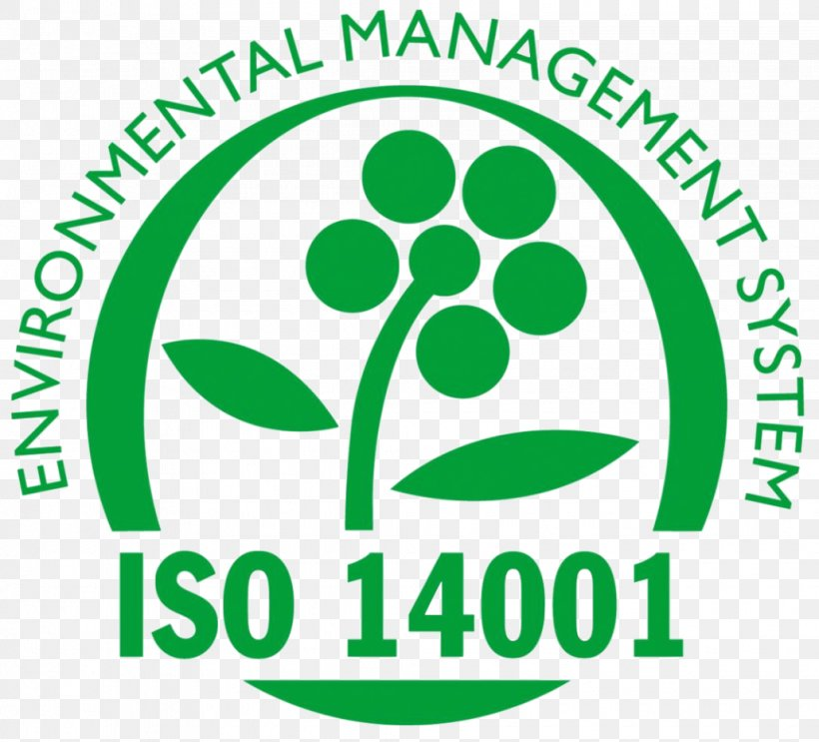
ISO 14000 (CO5)

Slide 80
Recap of ISO 14000
The primary objective of the ISO 14000 series of standards is to promote effective environmental management systems in organizations.

Slide 81
Daily Quiz
What is ISO 14000?
What are the key standards included in ISO 14000?
What are the Benefits of ISO 14000 Certification ?
What is the ISO 14001 environmental management system?
What are the difference between ISO 14000 and ISO 14001?

Slide 82
Objective of Quality Auditing
Quality audit is an audit which determines the extent to which quality requirements are fulfilled.
CO | PO1 | PO2 | PO3 | PO4 | PO5 | PO6 | PO7 | PO8 | PO9 | PO10 | PO11 | PO12
AOE0861.1 | 3 | 2 | 3 | 2 | 2 | 2 | 2 | 1 | 2 | 1 | 2 | 3

Slide 83
Prerequisites of Quality Auditing
ISO 14000
ISO 14001

Slide 84
Quality Auditing (CO5)
A quality audit is a process by which you review and evaluate an element of your business to ensure that you're meeting certain standards. The standards vary—you can set them or you can follow standards set by your industry.
Auditing is defined as the on-site verification activity, such as inspection or examination, of a process or quality system, to ensure compliance to requirements.
An audit can apply to an entire organization or might be specific to a function, process, or production step.
Some audits have special administrative purposes, such as auditing documents, risk, or performance, or following up on completed corrective actions

Slide 85
Quality Auditing (CO5)
A quality audit is an audit which determines the extent to which quality requirements are fulfilled. A quality audit will therefore independently examine processes, products and services to determine if they fulfill requirements specified for their inherent characteristics e.g. dimensions, functionality, safety and responsiveness. Quality audits may therefore be referred to as process audits, product audits, service audits or quality management system audits.
ISO 9000 define an audit as a systematic, independent and documented process for obtaining objective evidence and evaluating it objectively to determine the extent to which the audit criteria are fulfilled or put simply; an audit is a means to establish the extent to which performance meets the objectives for that performance

Slide 86
Quality Auditing (CO5)
Types of audits
Product audit: This type of audit is an examination of a particular product or service, such as hardware, processed material, or software, to evaluate whether it conforms to requirements (i.e., specifications, performance standards, and customer requirements).
System audit: An audit conducted on a management system. It can be described as a documented activity performed to verify, by examination and evaluation of objective evidence, that applicable elements of the system are appropriate and effective and have been developed, documented, and implemented in accordance and in conjunction with specified requirements

Slide 87
Quality Auditing (CO5)
WHAT ARE THE FOUR PHASES OF AN AUDIT CYCLE
Audit planning and preparation
Audit execution
Audit reporting
Audit follow-up and closure

Slide 88
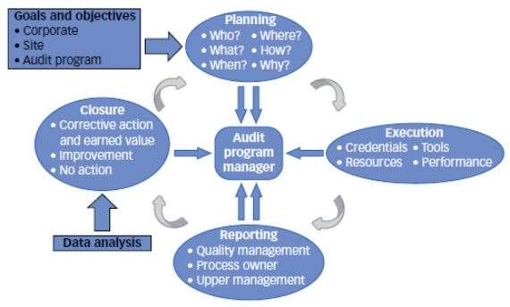
Quality Auditing (CO5)

Slide 89
Recap of Quality Auditing
Auditing is defined as the on-site verification activity, such as inspection or examination, of a process or quality system, to ensure compliance to requirements.

Slide 90
Daily Quiz
What is quality audit?
What are the classification of quality audits?
What are the four phases of an audit cycle?
What are the benefits of quality audits?
Define audit execution.

Slide 91
Objective of JIT
JIT is a manufacturing management process in order to meet consumer demands with minimum delays.
CO | PO1 | PO2 | PO3 | PO4 | PO5 | PO6 | PO7 | PO8 | PO9 | PO10 | PO11 | PO12
AOE0861.1 | 3 | 2 | 3 | 2 | 2 | 2 | 2 | 1 | 2 | 1 | 2 | 3

Slide 92
Prerequisites of JIT
Quality audit
Auditing is defined as the on-site verification activity, such as inspection or examination, of a process or quality system, to ensure compliance to requirements.

Slide 93
JIT (CO5)
Just-in-time also known as JIT is an inventory management method whereby labour, material and goods (to be used in manufacturing) are re-filled or scheduled to arrive exactly when needed in the manufacturing process
JIT is a manufacturing management process. It was first developed and applied in the Toyota manufacturing plants in order to meet consumer demands with minimum delays.

Slide 94
JIT (CO5)
The main focus of JIT is to identify and correct the obstacles in the production process. It shows the hidden problems of inventory.
Just In Time method prevents a company from using excessive inventory and smoothens production operations if a specific task takes longer than expected or a defective part is discovered in the system.
This is also one of the main reason why the companies (which are opted for JIT) invest in preventive maintenance; when a part/equipment breaks down, the entire production process stops.
The prime objective of JIT is to increase the inventory turnover and reduce the holding and all connected cost. This concept was made applicable again by the Japanese firms, placing an order for the material, the same day for the production of the product.

Slide 95
JIT (CO5)
Elements involved in JIT
Continuous improvement: Attacking fundamental problems and anything that does not add value to the product.
Simplicity: Simple systems are simple & easy to understand, easily manageable and the chances of going wrong are very low.
A product: oriented layout for less time spent on materials and parts movement.
Quality control at source to ensure every worker is solely responsible for the quality of their own produced output.
Eliminating waste: There are seven types of waste:Waste from product defects.
Waste of time.
Transportation waste.

Slide 96
JIT (CO5)
Inventory waste.
Waste from overproduction.
Processing waste.
Waste minimization is one of the primary objectives of Just In Time system. This needs effective inventory management throughout the whole supply chain.
Initially, a manufacturing entity will seek to reduce inventory and enhance operations within its own organization. In an attempt to reduce waste attributed to ineffective inventory management,
SIX principles in relation to JIT have been stated by Schniededans and they are:
Reduce buffer inventory.

Slide 97
JIT (CO5)
Try for zero inventory.
Search for reliable suppliers.
Reduce lot size and increase the frequency of orders.
Reduce purchasing cost.
Improve material handling.

Slide 98
JIT (CO5)
Advantages & Disadvantages of Just-In-Time Systems
Advantages of Adopting Just-In-Time include:
Just-in-time approach keeps stock holding costs to a minimum level. The released capacity results in better utilization of space and bears a favorable impact on the insurance premiums and rent that would otherwise be needed to be made.
The just-in-time approach helps to eliminate waste. Chances of expired or out of date products; do not arise at all.
As under this management method, only essential stocks which are required for to manufacturing are obtained, thus less working capital is required. Under this approach, a minimum re-ordering level is set, and only when that level is reached, order for fresh stocks are made and thus this becomes a boon to inventory management too.

Slide 99
JIT (CO5)
Due to the abovementioned low level of stocks held, the ROI (Return On Investment) of the organizations be high in general.
As this approach works on a demand-pull basis, all goods produced would be sold, and thus it includes changes in demand with unanticipated ease.
This makes JIT appealing today, where the market demand is fickle and somewhat volatile.
JIT emphasizes the ‘right-first-time’ concept, so that rework costs and the cost of inspection is minimized.
By following JIT greater efficiency and High-quality products can be derived.
Better relationships are fostered along the production chain under a JIT system.

Slide 100
JIT (CO5)
Higher customer satisfaction due to continuous communication with the customer.
Just In Time adoption result in the elimination of overproduction.
Disadvantages of Adopting JIT Systems
JIT approach states ZERO tolerance for mistakes, making re-work difficult in practice, as inventory is kept to a minimum level.
A successful application of JIT requires a high reliance on suppliers, whose performance is outside the purview of the manufacturer.

Slide 101
JIT (CO5)
Due to no buffers in JIT, production line idling and downtime can occur which would have an unfavorable effect on the production process and also on the finances.
Chances are quite high of not meeting an unexpected increase in orders as there will be no excess inventory of finished goods.
Transaction costs would be comparatively high depending upon the frequency of transactions.
JIT may have certain negative effects on the environment due to the frequent deliveries as the same would result in higher use and cost of transportation, which in turn would consume more fossil fuels.

Slide 102
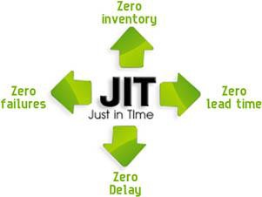
JIT (CO5)

Slide 103
Recap of JIT
Auditing is defined as the on-site verification activity, such as inspection or examination, of a process or quality system, to ensure compliance to requirements.

Slide 104
Daily Quiz
1. What is JIT?
2. What are the Elements involved in JIT?
3. What are the SIX principles in relation to JIT ?
4. What are the advantages of JIT?
5. What are the disadvantages of JIT?

Slide 105
FACULTY VIDEO LINKS, YOUTUBE & NPTEL VIDEO LINKS AND ONLINE COURSES DETAILS
https://www.youtube.com/watch?v=Q3EOCAuExJU
https://www.youtube.com/watch?v=yWlAOFs04go
https://www.youtube.com/watch?v=QifqIoUNTJM
https://www.youtube.com/watch?v=qb3mvJ1gb9g
https://www.youtube.com/watch?v=2ePeXePNLrs
https://www.youtube.com/watch?v=HkdoR-NNEoI
https://www.researchgate.net/publication/318654507_Total_Quality_Management_Notes
http://www.mescenter.ru/images/abook_file/Total_Quality_Management_and_Six_Sigma.pdf

Slide 106
MCQ
1. ISO 14000 quality standard is related with
a. Environmental management systems b. Automotive quality standards c. Eliminating poor quality d. Customer satisfaction
2. Which ISO standard is used in international automobile companies to set automotive quality system standards ?
a. ISO 14000 b. TS 16949 c. ISO 9000 d. none of the above

Slide 107
MCQ
3. The aim of Just-In-Time manufacturing principle is to eliminate
a. time wastage b. labour wastage c. cost of excessive inventory d. all of the above
4. How many stages are needed for inspection and testing in TQM as per ISO 9001? a) 1 b) 2 c) 3 d) 4

Slide 108
MCQ
5. The objective of ISO-9000 family of Quality management is
Customer satisfaction
Employee satisfaction
Skill enhancement
Environmental issues
6. TQM & ISO both focuses on
Customer
Employee
Supplier
All of the above

Slide 109
MCQ
7. What is ISO?
Indian organization for standard
Internal organization for standard
International organization for standard
None of the above
8. EMS stands for
Environmental management system
Employees management system
Engineering management system
Equipment management system

Slide 110
MCQ
9. ISO emphasis on
Prevention
Inspection
Rejection
All of the above
10. ISO – 14001 gives stress on
Plan – Do -check -Act
Environmental protection
Prevention rather than detection
All of the above

Slide 111
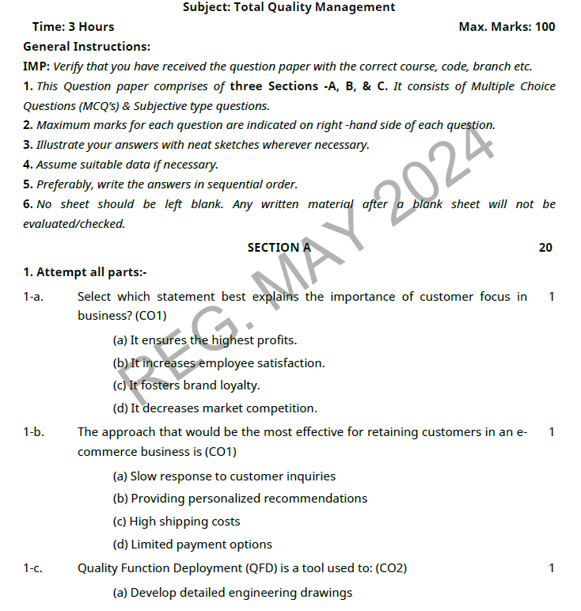
OLD QUESTION PAPERS

Slide 112
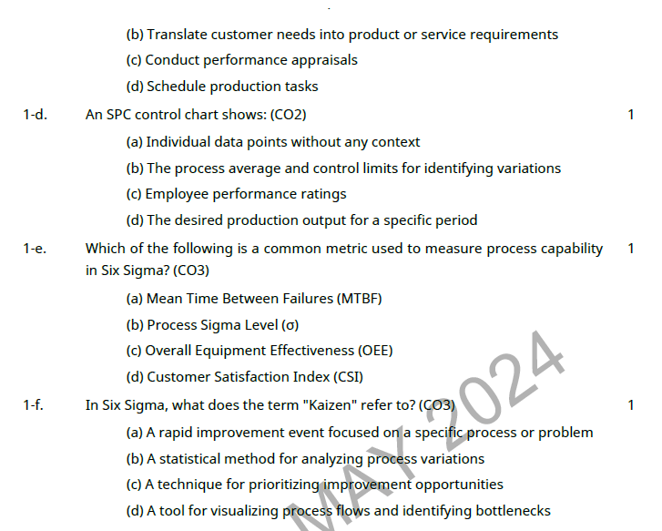
OLD QUESTION PAPERS

Slide 113
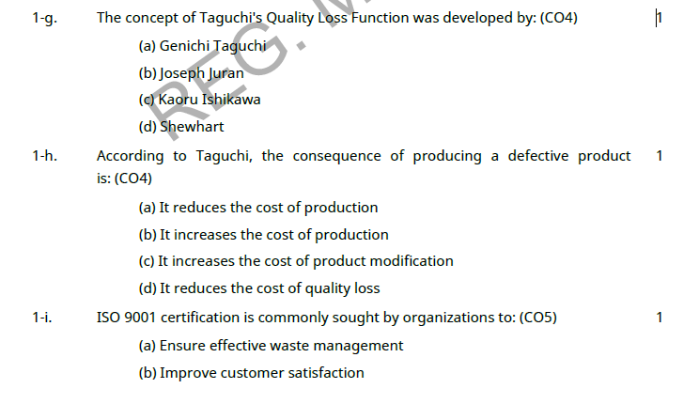
OLD QUESTION PAPERS

Slide 114
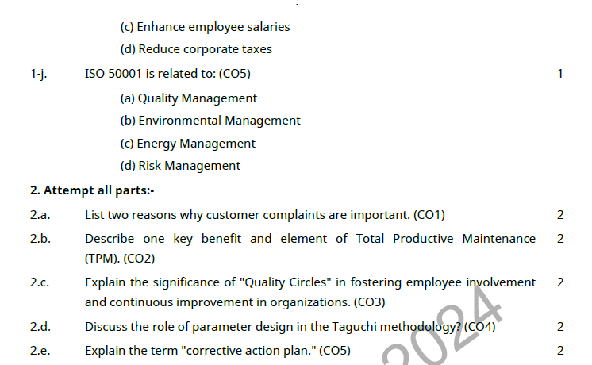
OLD QUESTION PAPERS

Slide 115
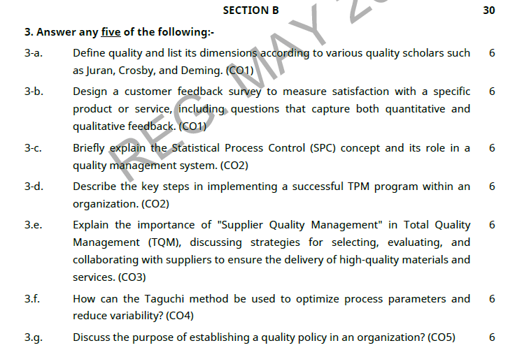
OLD QUESTION PAPERS

Slide 116
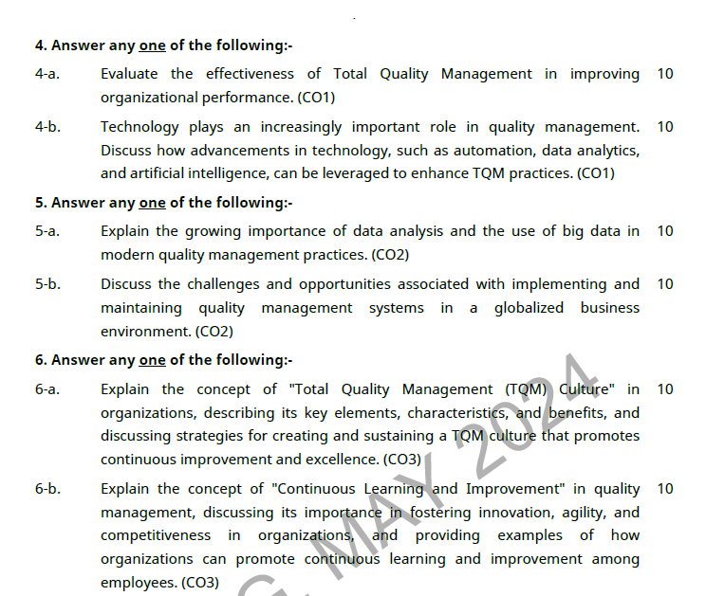
OLD QUESTION PAPERS

Slide 117
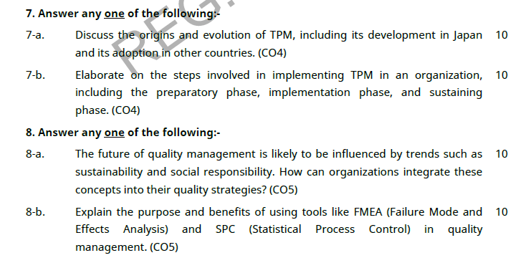
OLD QUESTION PAPERS

Slide 118
EXPECTED QUESTIONS FOR UNIVERSITY EXAM
Explain the implementation and documentation of Quality System? Implementation steps.
Explain the Benefits of ISO 14000?
Why is ISO 9000 important?
What are the objectives of reliability and how we can evaluate for a product?
State the objectives and benefits of JIT.
Explain the step followed to get ISO 9000 certification for educational institute.

Slide 119
EXPECTED QUESTIONS FOR UNIVERSITY EXAM
7. What are the requirements of ISO 14001?
8. What are the four elements for the planning of ISO 14001?
9. Give the types of Organizational Evaluation Standards?
10. What are the methods of actual audit?
11. What is JIT?

Slide 120
Summary
A quality management system (QMS) is a collection of business processes focused on consistently meeting customer requirements and enhancing their satisfaction. It is aligned with an organization's purpose and strategic direction (ISO9001:2015).

Slide 121
Summary
It is expressed as the organizational goals and aspirations, policies, processes, documented information and resources needed to implement and maintain it. Early quality management systems emphasized predictable outcomes of an industrial product production line, using simple statistics and random sampling.
By the 20th century, labor inputs were typically the most costly inputs in most industrialized societies, so focus shifted to team cooperation and dynamics, especially the early signaling of problems via a continual improvement cycle.

Slide 122
Summary
In the 21st century, QMS has tended to converge with sustainability and transparency initiatives, as both investor and customer satisfaction and perceived quality is increasingly tied to these factors.
Of QMS regimes, the ISO 9000 family of standards is probably the most widely implemented worldwide – the ISO 19011 audit regime applies to both, and deals with quality and sustainability and their integration.

Slide 123
References
Text Book
Lt. Gen. H. Lal, “Total Quality Management”, Eastern Limited
Greg Bounds, “Beyond Total Quality Management”, McGraw Hill
Menon, H.G, “TQM in New Product manufacturing”, McGraw Hill
Reference Book
Total Quality Management” by Besterfield
“Total Quality Management” by Mukherjee
Total Quality Management” by Vijayan
“Total Quality Management- Text and Cases” by Janakiraman B and Gopal R K
https://www.researchgate.net/publication/318654507_Total_Quality_Management_Notes

Slide 124
Thank You

